Slide 1
Computational Thinking
Core Concepts

Slide 2
What is Computational Thinking?
Computational thinking is a way of understanding complex problems in order to form a solution that can be implemented by either a computer, a human or a combination of both.
There are four key elements to computational thinking:
Decomposition - breaking a problem down into smaller pieces
Abstraction - removing details that are not relevant to solving a problem
Algorithmic thinking - identifying logical steps/a set of instructions that can be used to solve a problem
Pattern Recognition - Finding patterns or similarities

Slide 3
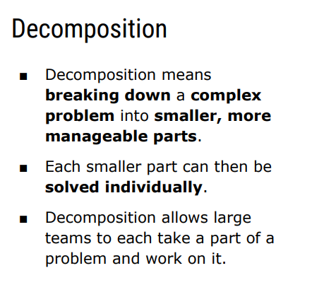

Slide 4
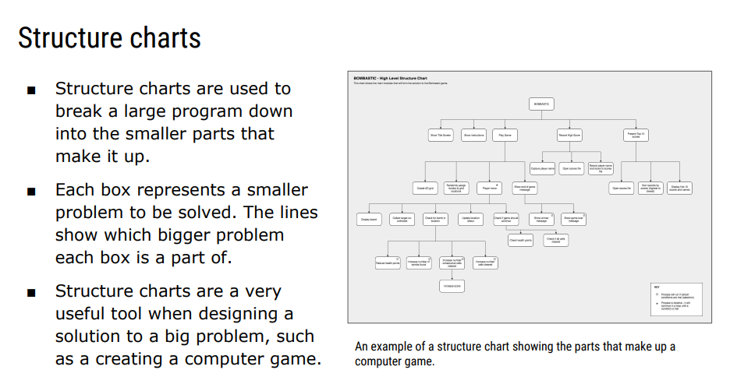

Slide 5
Abstraction
A Technique that is used to simplify a problem by removing unnecessary parts.
Allows you to focus on what is important and relevant
Where is abstraction useful.
Give an example of how abstraction might be used in
Maths
English
Geography

Slide 6
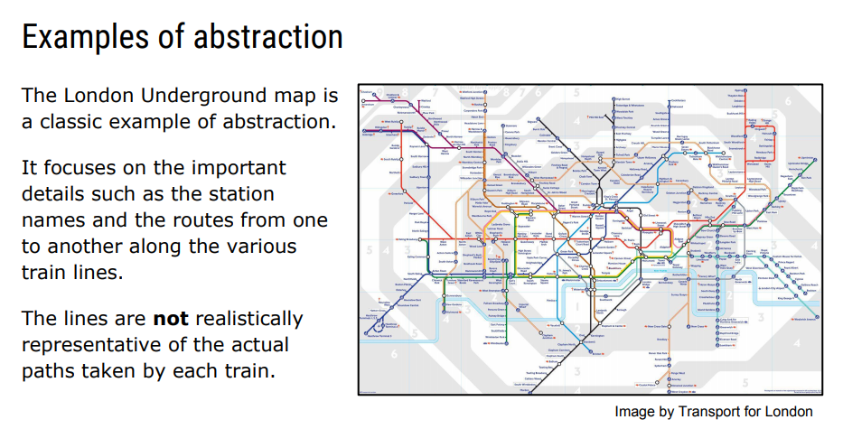

Slide 7
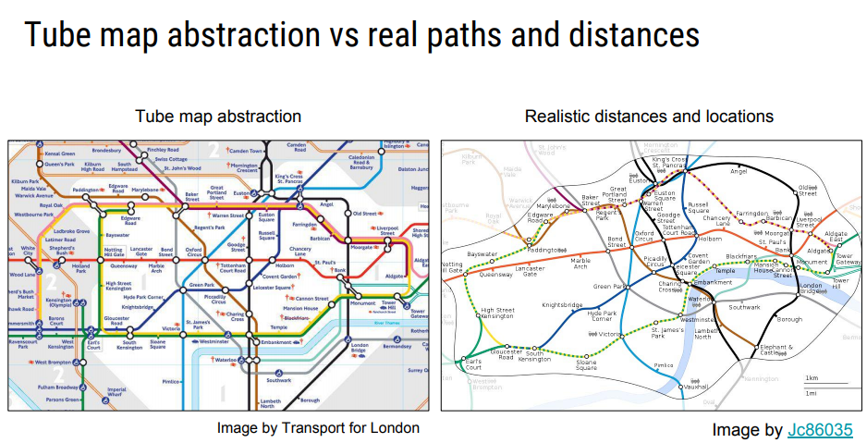

Slide 8
